Slide 1
VX 420: Business Basics for Entrepreneurship
The Lean LaunchPad: Distribution Channels
Version 6/15/12

Slide 2
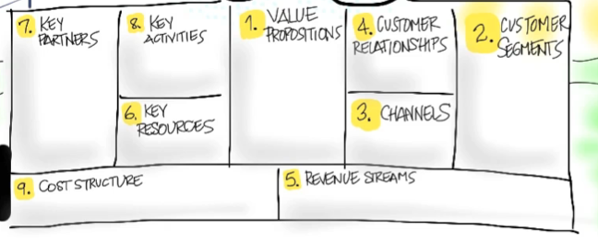
Channels
How does your Product Get to Customers?

Slide 3
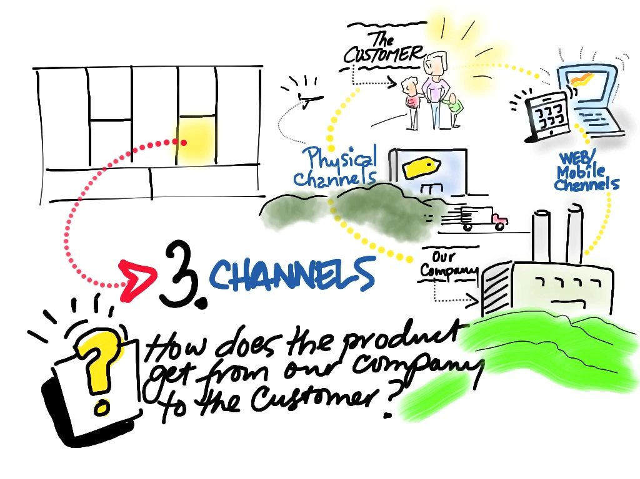
© 2012 Steve Blank

Slide 4
Physical versus Virtual Channels

Slide 5
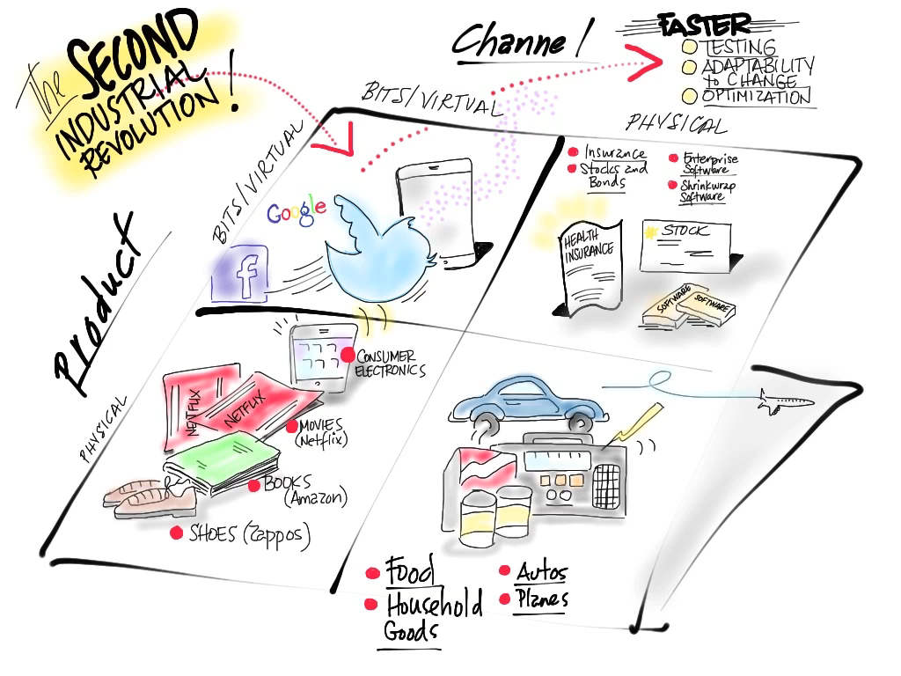

Slide 6
How Do You Want Your Product to Get to Your Customer?
ü
Yourself
Through someone else
Retail
Wholesale
Bundled with other goods or services
ü
ü
ü
ü

Slide 7
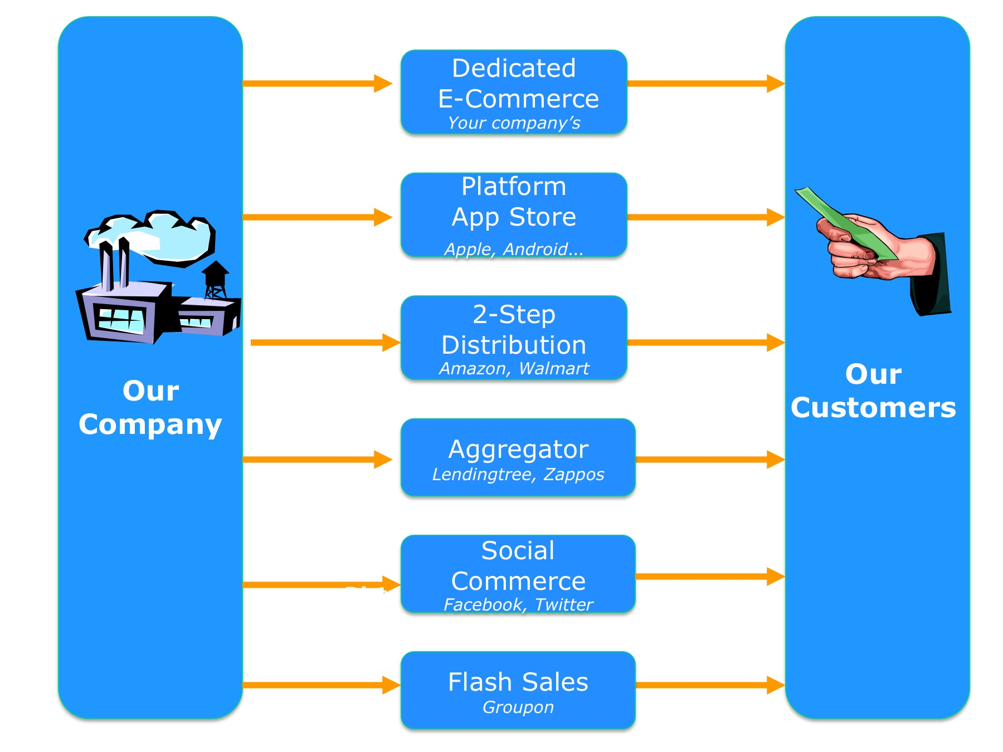
Web Channels

Slide 8
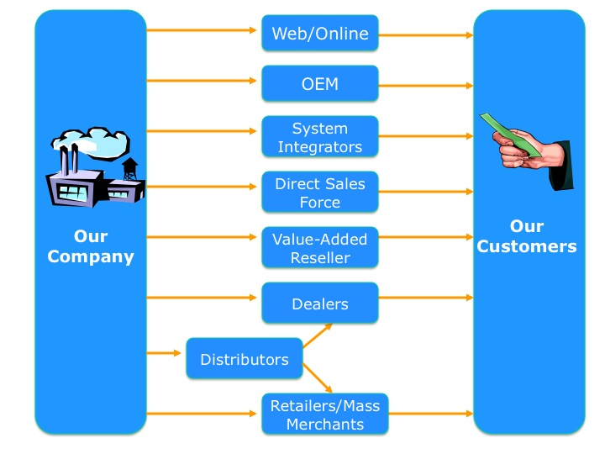
Physical Channels

Slide 9
How Does Your Customer Want to Buy Your Product from your Channel?
ü
Same day
Delivered and installed
Downloaded
Bundled with other products
As a service
…
ü
ü
ü
ü
ü

Slide 10
Types of Channels
Direct
Indirect
Licensing
OEM
VAR
Reseller
Distributor

Slide 11
Distribution Complexity
Evangelists
Global Systems
Systems Integrators
WANs
Mainframes
Direct Sales
Higher Volume
Minis
LANs
Marketing Complexity
VARs
PC Servers
Higher Value Added
Desktop PCs
Retail
Printers
Keyboards
Service Technicians
Web, Telesales
Toner
Solution Complexity

Slide 12
How Do the Economics Work in Different Sales Channel?

Slide 13
How Are Channels Compensated?
Commission
Percentage of sales price
Discounted pre-purchase

Slide 14
Channel Economics: “Direct” Sales
List Price
Your Revenue
Cost of Goods (Supply Chain)
Profit + SG&A + R&D
EU Discounts
End Consumer
Source: Mark Leslie, Stanford GSB

Slide 15
Channel Economics: Resellers
List Price
Your Revenue
Cost of Goods (Supply Chain)
Profit + SG&A + R&D
Reseller
EU Discounts
End Consumer
Source: Mark Leslie, Stanford GSB

Slide 16
Channel Economics: Distributors/Resellers
List Price
Your Revenue
Cost of Goods (Supply Chain)
Profit + SG&A + R&D
Distributor
Reseller
EU Discounts
End Consumer
Source: Mark Leslie, Stanford GSB

Slide 17
The Channel as a Customer
Some products are embedded in others (OEM)
Some products are resold by others (VARs)
Some products are distributed by others
Who’s the customer?

Slide 18
Channel Economics: OEM or IP Licensing
List Price
Your Revenue
Cost of Goods (Supply Chain)
Profit + SG&A + R&D
Master Distributor
Distributor
Reseller
EU Discounts
End Consumer
Cost of Goods (Supply Chain)
Profit + SG&A + R&D
Reseller
Your Product Becomes Your Customer’s Cost of Goods
Source: Mark Leslie, Stanford GSB

Slide 19
How Are Channels Motivated or Incented?
Money! – what makes them the most?
Training
Marketing to the channel
SPIF

Slide 20
Book Publishing Channel Example

Slide 21
Example: Book Publishing
Publisher
National Distributor
Printer
Wholesaler
Retailer
Customer

Slide 22
Book Publishing
Publisher
National Wholesaler
Distributor
Retailer
Customer
Percent of Retail
35%
15%
10%
40%
$7.00
$3.00
$2.00
$8.00
$20.00
You get
35% of retail
the distributor gets 10%
the wholesaler gets 15%
the retailer gets 40%
less any discount they offer the customer

Slide 23
Book Publishing Economics
Publisher
National Distributor
Wholesaler
Retailer
Customer
Allowances
Wholesale costs
Bills
Markup
Credit guarantees
Payment guarantees
Payment guarantees
Return rights
Credits
Payments

Slide 24
Book Publishing Delivery
Publisher
National Distributor
Printer
Wholesaler
Retailer
Prepare film (content)
Receive
Schedules
Print orders
Bundle counts
Film
Determine allocations
Merchandise titles
Deliver orders
Sell magazines
Establish identity
Create demand
Prepare galleys
Print and ship magazines
Dispose of returns
Acknowledge returns

Slide 25
Medical Device Channel Example

Slide 26

Product flow/Channel
Electronic Health Records
Fluid Synchrony
Partners/
OEMS
Electronic Records
Support Services
Pump + Controller
Bundled Kits
.
Hospitals
(Anesthesiologists
Neurosurgeons)
Patients
Pain Clinic
(Anesthesiologists
Neurosurgeons)

Slide 27
Hospitals
Channels (Direct)
Pain Clinics
Direct to institutions
Some formularies involved in purchase decisions
Some doctors make purchase decision directly
Device company/Doctor relationship is key
Heavily influenced by :
Clinical study results
Regulatory approval
Reimbursement

Slide 28
Farm Sensor Industry Channel Example

Slide 29







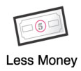

Channel Model: Service Provider
Product
Money
OEM
Nutrient Data
Large farm
Us
Small farm
USDA/EPA
Licensing/sales

Slide 30
Channel Model: Service Provider
Product
Money
OEM
Nutrient Data
Large farm
Product
Us
Small farm
Service
USDA/EPA
Licensing/sales

Slide 31
Dental Product Channel Example

Slide 32
COST / PROFIT ANALYSIS
Licensing Revenue Model
Per unit cost and profit estimation
Our revenue 4-8% revenues
List price
R&D
Maintaining IP
Univ.
License
fee
Raw materials
Manufacturing &
Packaging
License fee
Distribution
End user

Slide 33
Licensing of Technology Ecosystem
University
Insurance
Agencies
2-4% license fee
$$$
DMX
R&D
Products
Procedures
IPs
Health-Care Providers:
Hospitals
Practitioners
Clinics
End User
$$
4-8% royalty
~$40
Customer segment: Large corporations
J&J, GSK, 3M

Slide 34
Medical Device Channel Example

Slide 35
MammOptics
Channel Strategies and Costs
Individual Doctors
High value medical products
(e.g. cardiovascular stents)
Direct Sales
Individual
Doctors
Doctor education
Direct feedback from doctors
Very expensive
Purchasing Administrators
Commodity medical products
(e.g. latex gloves)
Purchasing Administrators
Distributors
No doctor education
No customer feedback
Inexpensive

Slide 36
MammOptics
Channel Strategies and Costs
Sales strategy 1
Sales strategy 2
5 dedicated sales people
$150,000 each/year
Hire nurses or technicians
with established
relationships
Early adopter feedback
Continue with core group of sales people
Use women’s healthcare equipment distributor
Already established network of customers

Slide 37
Dental Product Channel Example

Slide 38



Channels
Direct Sales
Big Distributors
Private Practice
Dentist
Institutional
Dentist
Purchasing
Department

Slide 39
Channels
Direct Sales
Big Distributors
80% Market Share
30% Margin
Private Practice
Dentist
Institutional
Dentist
Purchasing
Department

Slide 40
Channels
Continuing
Education
Courses
Magazines
& Email
Trade
Shows
Direct Sales
Big Distributors
80% Market Share
30% Margin
Private Practice
Dentist
Institutional
Dentist
Purchasing
Department

Slide 41
Online Rental Channel Example

Slide 42
PM Tools
Rentpost.com
Listings Provider
Rentjuice.com
Buildium.com
Potential Landlords
Craigslist
Rentingsmart.co
Padmapper.com
Propertyware.com
Rent.com
Show, Advise, Valuate
Apartment.com
propertymanagemnt360
Realtors
Forrent.com
Rentjuice.com
Propertyware.co
Sell, Advise
Trulia.com
Landlords
Credit Checks
Safetenantcheck.c
Erenter.com
Property
Managers
Listings,
Checks
Rent Payment
Buildium.com
Listings,
Checks
Rent Payment
Payment Facilitator
Maintenance Ratings
Rentpayment.com
Tenants
Clearnow.com
Yelp.com
Online Cheque
Maintenance
Furnishing
Rentingsmart.co
Angie’s List
Moving
Find information
Service Providers
Maintenance Finding
Zoospi.com
Redbeacon.com
Taskrabbit.com
Servicemagic.com
Schedule Tools
Web Info
Setster.com
Zoospi.com

Slide 43
Dental Product Channel Example

Slide 44
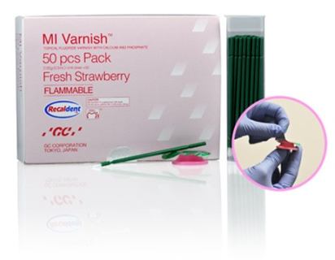
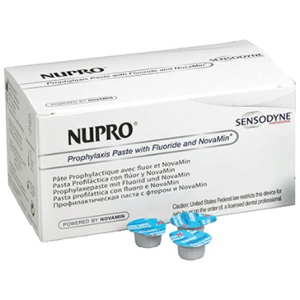
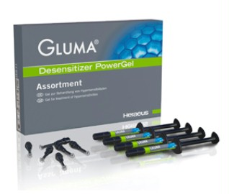
COST / PROFIT ANALYSIS
Direct Sales Revenue Model
Our revenue
$27
List price
$40 *
Per unit cost and profit estimation
%32 cut
Raw active ingredient
Manufacturing &
Packaging
Profit + R&D + License fee
Distributor
End user
$6
? ($5)
~$11
~$13
* Competition
NuPro prophy paste (Novamin $50)
NuPro desensitizer (Novamin $93)
MI varnish (Recaldent $100)
Gluma desensitizer (Glutaraldehyde $130)
Health-Dent desensitizer (Fluoride $49)

Slide 45
Direct Sales Ecosystem
R&D &
Regulation
University
Insurance
Agencies
$?
$$??
Raw Materials
Manufacturing
DMX
R&D
Products
Procedures
IPs
$6/pk
Customer Segments;
Health-Care Providers:
- Hospitals
- Practitioners
- Clinics
End User
Formulations
& Packaging
$5/pk
$$??
-32%($27)
Product Sales & Distribution
$40/pk

Slide 46
Travel Industry Channel Example

Slide 47
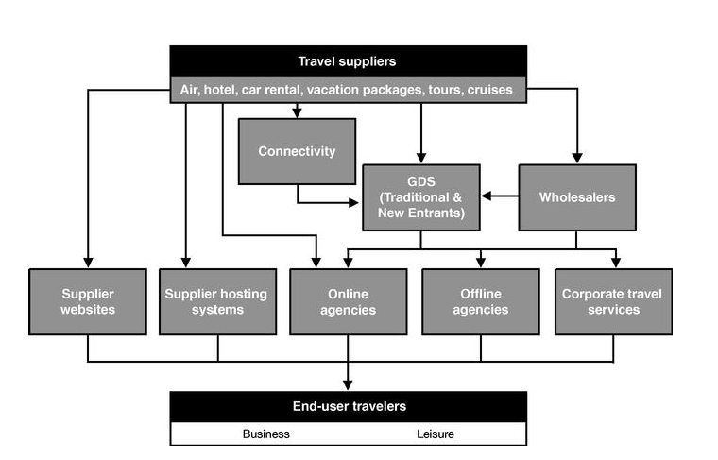
Travel Services: Impact of Changing Technology

Slide 48
The Advent of GDS Systems (1980 -1995)

Slide 49
Turning the Screen Around Online Travel (1995-2010)

